Slide 1
WELCOME
Tekcircuits R&D Lab - #11-13-915, 3rd Floor, Road No 1, Greenhills Colony, Kothapet, - Hyderabad-500035 Telangana State – India
For more assistance: visit: www.tekcircuits.com / email: info@tekcircuits.com / contact Support: Tel: +91-9441242825

Slide 2
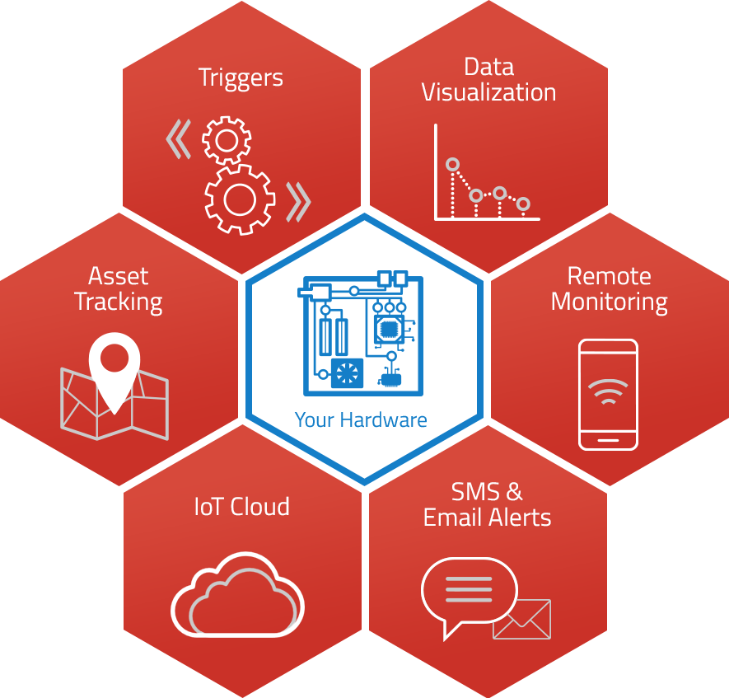
Narsimulu Cinasi
Designation: Managing Director
Company: Tekcircuits R&D Lab
Contact: +91 9108456695
Email: narsim@tekcircuits.com
Website: www.tekcircuits.com
Exp: 5 Years’ experience in Embedded Software Development (Automation and Automotive)
Tekcircuits R&D Lab - #11-13-915, 3rd Floor, Road No 1, Greenhills Colony, Kothapet, - Hyderabad-500035 Telangana State – India
For more assistance: visit: www.tekcircuits.com / email: info@tekcircuits.com / contact Support: Tel: +91-9441242825

Slide 3
What we do in the workshop
Introduction to IOT
Introduction to Arduino IDE
Introduction to NODEMCU(Esp8266 SOC)
Hands on Arduino IDE USING NODEMCU
Connecting Devices to Clould(IOT Hands On)
Send Voltage & Analog Data on Cloud Server.
Use Arduino to Upload free data from Environmental Sensors to Cloud Server.
Being Social on Twitter & update status on Twitter through Arduino
Automatically Tweet Sensor Data on Twitter.
Receive Automatic Call Notification on Mobile Phone for Burglar Alarm using IoT Platform.
Creating own Android App using MIT App Inventor & controlling Arduino connected devices.
Tekcircuits R&D Lab - #11-13-915, 3rd Floor, Road No 1, Greenhills Colony, Kothapet, - Hyderabad-500035 Telangana State – India
For more assistance: visit: www.tekcircuits.com / email: info@tekcircuits.com / contact Support: Tel: +91-9441242825

Slide 4
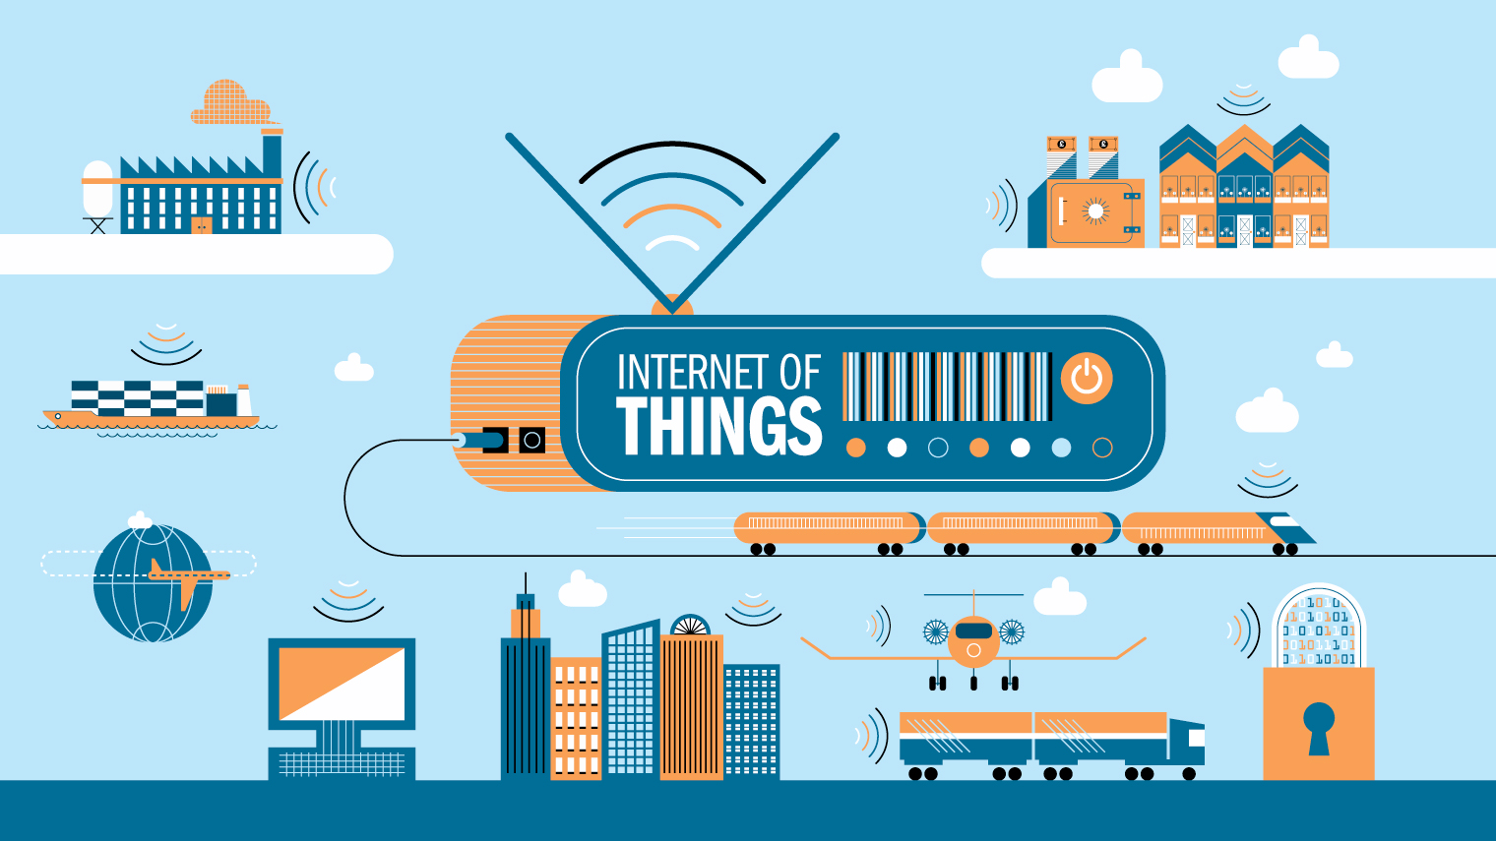

Slide 5
What is IoT?
Information Security
Office of Budget and Finance
Education – Partnership – Solutions
The Internet of Things (IoT) is the network of physical objects—devices, vehicles, buildings and other items embedded with electronics, software, sensors, and network connectivity—that enables these objects to collect and exchange data.

Slide 6

The IoT Market
Information Security
Office of Budget and Finance
Education – Partnership – Solutions
As of 2013, 9.1 billion IoT units
Expected to grow to 28.1 billion IoT devices by 2020
Revenue growth from $1.9 trillion in 2013 to $7.1 trillion in 2020

Slide 7
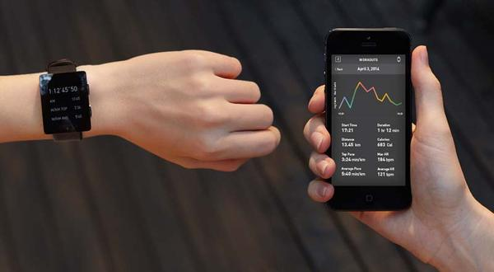
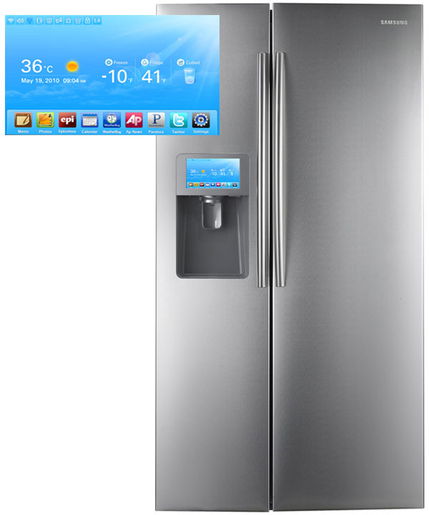
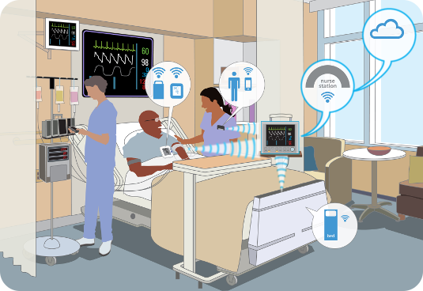
Information Security
Office of Budget and Finance
Education – Partnership – Solutions
Smart Appliances
Wearable Tech
Healthcare

Slide 8
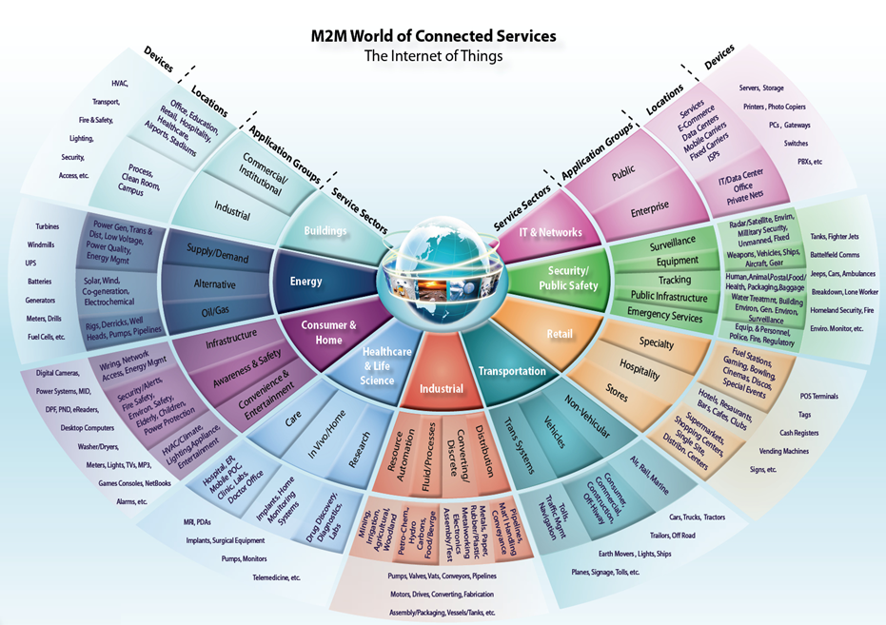
Information Security
Office of Budget and Finance
Education – Partnership – Solutions

Slide 9
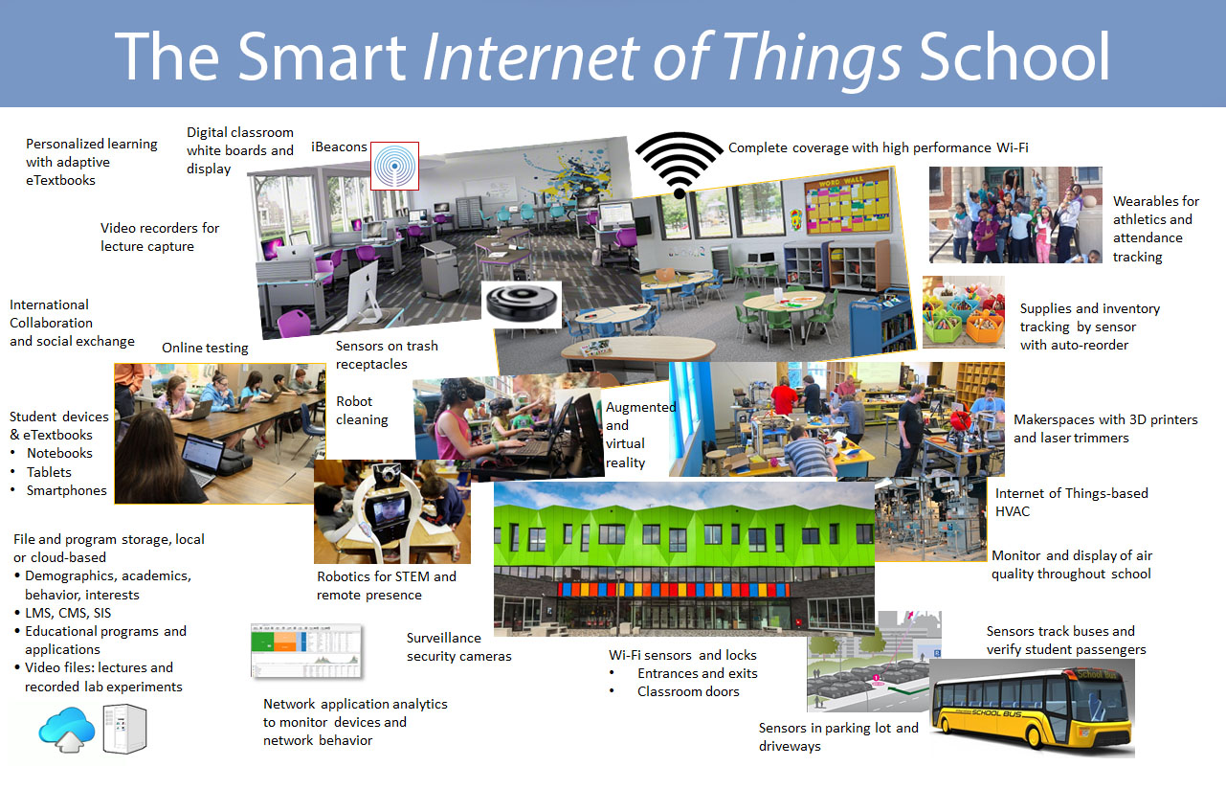
Information Security
Office of Budget and Finance
Education – Partnership – Solutions

Slide 10

Questions and Discussion
Information Security
Office of Budget and Finance
Education – Partnership – Solutions

